Slide 1
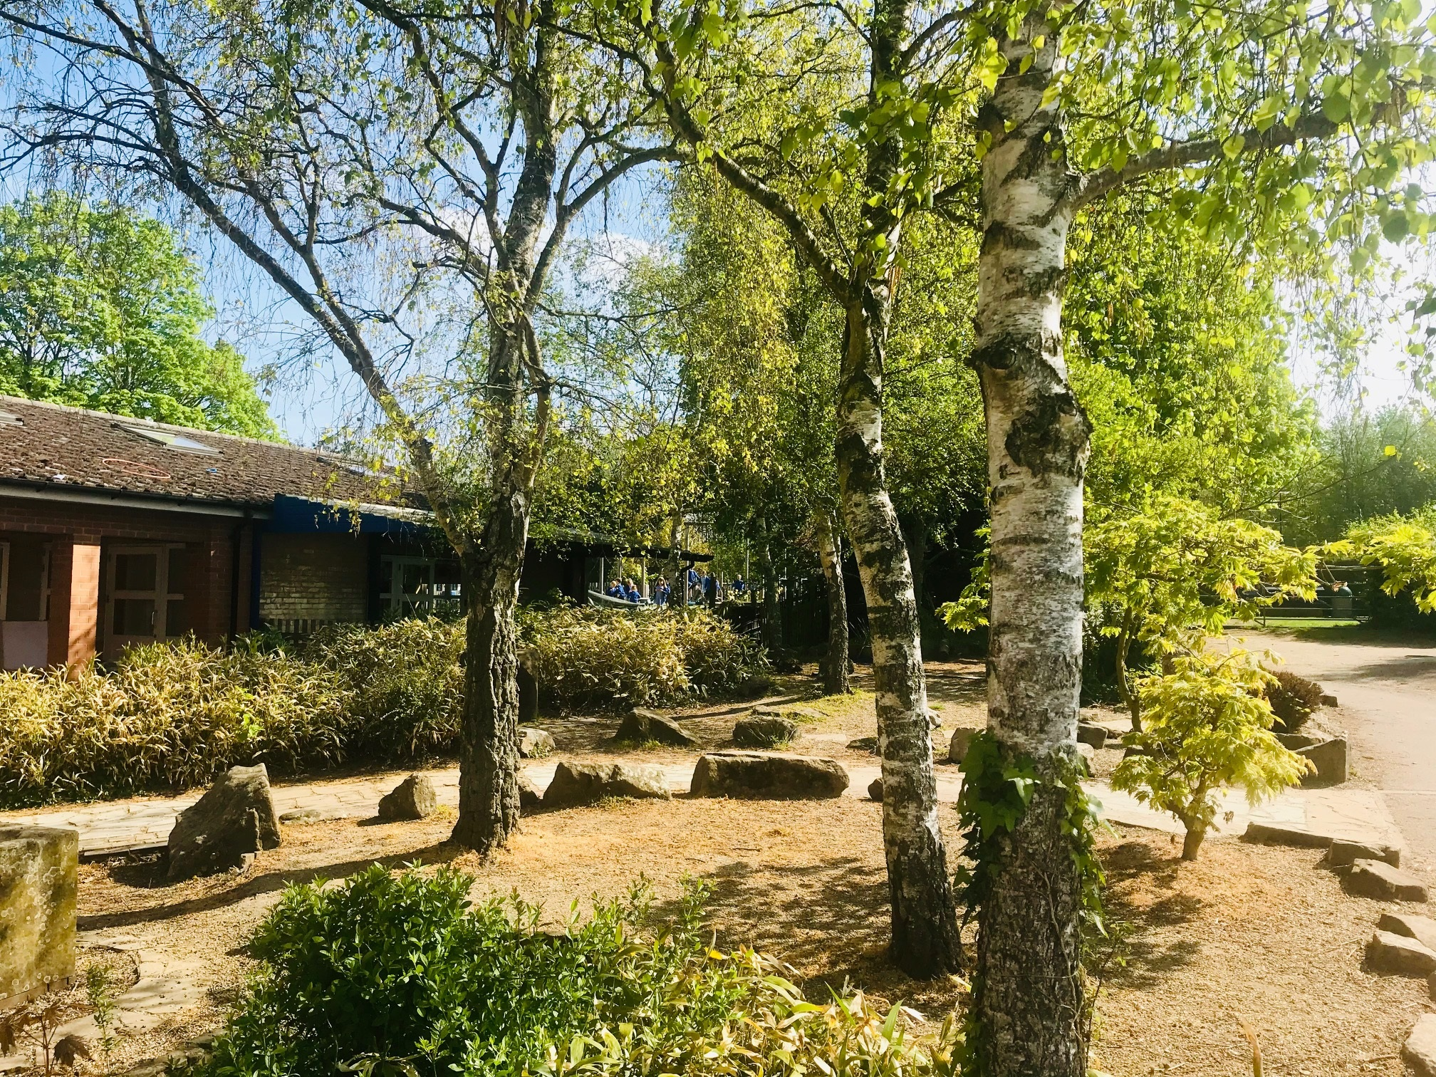
Responses to Summer Reports
Feedback from our parent body

Slide 2

I thought that the letter home was a gorgeous idea and it was a joy to read with xxx. I felt very emotional and extremely proud of her and I think she got a real sense of that too. It was a lovely touch after, as you say, such an extraordinary introduction to education!
Thank you for ALL that you do for the children of Great Milton. What a beautiful school it is.

Slide 3
We thought the 2 ways of sending out the report were equally useful and needed. The letter gave a practical and 'child centred' amount of information which could be shared with the children as a positive encouragement as they prepare for moving up a year, and gave useful insights into the level the child is at. The more formal report was also necessary to get a good idea of their level of academic achievement in context of expected standards. Great to have both. Do it again please!

Slide 4
A huge thank you to you all for all your help and support in what has been a very hard year. We are so pleased with the progress xxx has made. She will miss Mrs X next year!
The personal letters from the teachers were a lovely idea and very appreciated. Thank you so much.

Slide 5
The personal letter was a lovely touch! Thank you for making the reports process that bit more special!

Slide 6
Thank you very much for your report. Xxx really appreciated receiving it in the post. She was very happy and enjoyed reading it. She was very proud and we are sure it boosted her confidence. We felt it was very personal and lovely to hear how you have seen xxx develop despite the challenging year. Thank you for all your hard work, it is much appreciated. Great Milton has a fantastic team. We love the school.

Slide 7
What a wonderful report and Pupil Profile. It was beautifully written and I loved the way they were written to the children which gave xxx a sense of pride and more involvement in her own learning.
Thank you so much to Miss X for being such a fabulous teacher and moving xxx on both academically and in her confidence.

Slide 8
We really appreciate the thoughtful approach.
Your attention to detail of the children’s needs and experience throughout has been brilliant.

Slide 9
Thank you for all the effort put into these reports. I loved the new report style and it is so thoughtful and inclusive to send them to the children.
Change, evaluation, reflection and not being afraid to try something new are all reasons why Great Milton is GREAT! Thank you all.

Slide 10
Mrs X has been absolutely fantastic for xxx. He speaks very fondly of her and has happily run into class everyday which speaks more than words.
I'm really happy with the way he is coming along, especially as he's an August birthday, and that's a credit to her, the team and the whole school.

Slide 11
I appreciated the way the reports were presented this year and I felt it sent a really positive message to the children and highlighted the great connection they have with their teachers.
I recognise it must have taken a great deal of effort from the teachers to write such long and detailed letters but it was a great way to make the children feel appreciated. Thank you!

Slide 12
We absolutely loved reading xxx’s report. The format was really lovely and I particularly loved how it was addressed directly to the child. It was all written in such a positive way, with a strong focus on effort and progress, rather than attainment - thank you!
Great Milton is such a supportive school with a focus on the whole child, and I'm so grateful for that.

Slide 13
Xxx's report was delightful, and it's lovely to hear all about all of the things she does whilst in school. What shines through is how well Mrs X knows xxx and how much she genuinely cares about her. She is a very devoted teacher.
Huge thanks to Mrs X, and her fabulous team.

Slide 14
I really loved reading the letter to xxx. It was a lovely touch to be written to xxx focussing on her strengths and areas to improve on. I loved hearing how she was doing and how she interacts with the other children.
Thank you very much.

Slide 15
We felt the format for the report was wonderful and really personal. Our child felt a much bigger sense of achievement as the letter was directed at him rather than us.
Great idea. Thank you!

Slide 16
Wonderful is all I can say. Xxx’s report was heartfelt, informative and reflected how much love and dedication has been shown by all members of staff.
GM is an amazing school and I feel blessed that xxx is part of it.

Slide 17
Thank you for this. A really lovely and personal way to communicate the letter and report which was detailed in both xxx’s personal and academic progress. We feel incredibly lucky to have had Mrs X and her team teach xxx this year. A fantastic start for her to feel happy, safe and keen to learn at school.
We do not underestimate the importance of this as a critical foundation for the next years of her education.

Slide 18
It's our first year for getting a school report and whilst I understand we have little experience and it's been a very disrupted year, I feel like we know very little about how our son is getting on as the reports feel very generic.

Slide 19
In the past, the reports included a photo of them in school, which was lovely to see and other reports often had the child's view included.
Not suggesting these as something I really want to see but merely as ideas I really liked about your reports in the past.

Slide 20
Thank you to all parents for your feedback. We are humbled by your praise and thanks and will take on board all constructive feedback going forward.
We are a very reflective school and are always looking for ways to improve. Your feedback is vital to this process.
Working Together- Striving for Excellence

